Slide 1
Array processing
GEOPH 677: Lecture 10

Slide 2
S-P time earthquake location
link
link

Slide 3
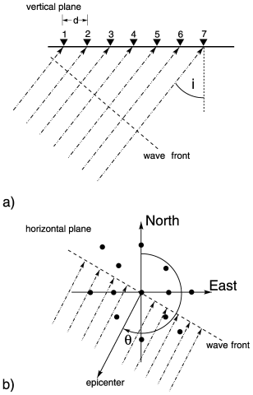
Array geometry and parameters

Slide 4
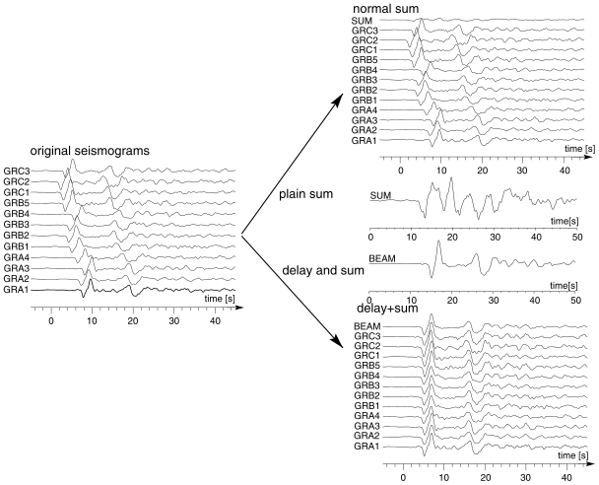
Delay and sum method

Slide 5
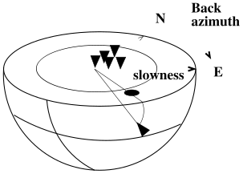
F-k analysis

Slide 6
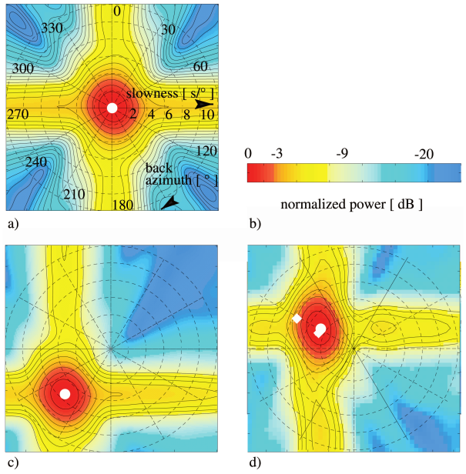
F-k array response function (ARF)

Slide 7
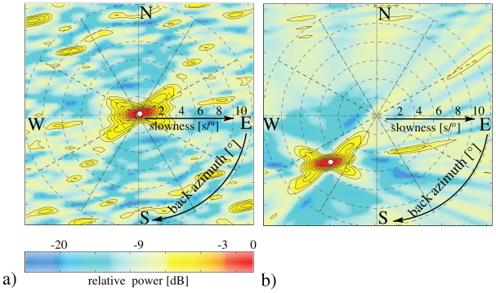
F-k ARF from a different array

Slide 8
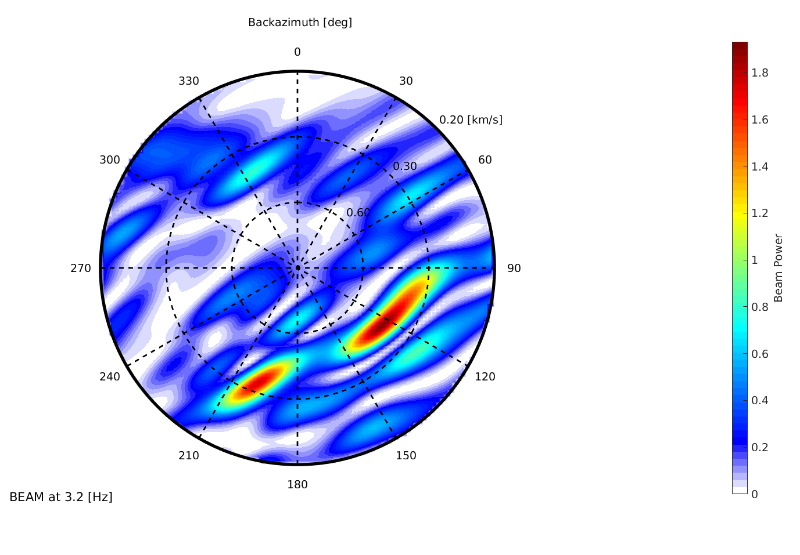
Near-surface gas bubbles

